Slide 1


2nd IPR Combat Dining In
Air Force ROTC Detachment 842
The University of Texas at San Antonio
C/Silva & C/Hernandez
20 Oct 23

Slide 2


Overview
Cadet Schedule
Parking Plan
Food Schedule
Final Seating Layout
Prep/Serving Station Layout
The Grog
Script
Costs
Confidence Course Questions
Positions
Additional Points
Questions
Air Force ROTC Detachment 842 • We Build Exceptional Officers • The University of Texas at San Antonio

Slide 3
Cadet Schedule
Arrive Parking lot: 0730
Accountability: 0745
Leave UTSA: 0800
Arrive/In Processing: 0825
Briefings: 0840
Begin Activities: 0850
Rotations 10 Minutes per 2 courses: 1100
Race Through the Obstacles: 1230
Transition to the dining area, Arrive: 1245
NOTES:
We can extend time for instructions if needed and cut into race time to allow all cadets to run through as some may be more difficult.
Air Force ROTC Detachment 842 • We Build Exceptional Officers • The University of Texas at San Antonio

Slide 4
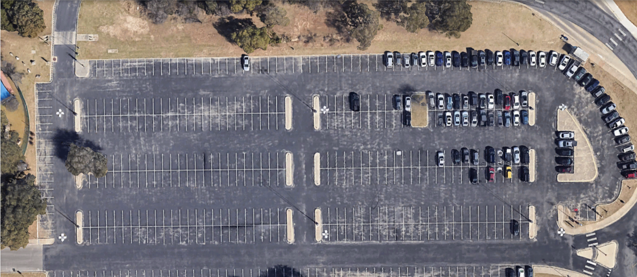
Parking Plan
Cadets will meet here transfer into cars and wait till we have accountability and the green light.
Entrance from Barshop Parking lot
Golf Flight
Juliet Flight
Hotel Flight
Kilo Flight
India Flight
Lima Flight
Air Force ROTC Detachment 842 • We Build Exceptional Officers • The University of Texas at San Antonio

Slide 5
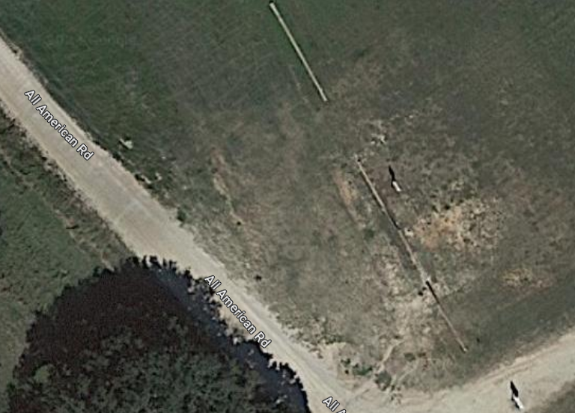
Parking Plan Cont.
Poc Will remain parked at Rod and Gun however Safety team will arrive early with Execution team to setup area before hand.
SQ 1 and 2 will park alongside here if we do not march to Training Site 13.
If parked here we will see a time jump of 15 minutes due to less maneuvering.
SQ 1
SQ 2
Air Force ROTC Detachment 842 • We Build Exceptional Officers • The University of Texas at San Antonio

Slide 6
Food Schedule
0900 We begin unloading equipment and setting up the area
1000 We start beginning the preparation to start cooking the burgers
1030 We begin heating up equipment
1100 We start grilling the burgers In the meantime we get everything ready to start serving like condiments etc.
1200 Burgers should start to finish being done
1300 We start serving the food
1330 We enjoy the festivities
1400 begin packing up to go home
Air Force ROTC Detachment 842 • We Build Exceptional Officers • The University of Texas at San Antonio

Slide 7
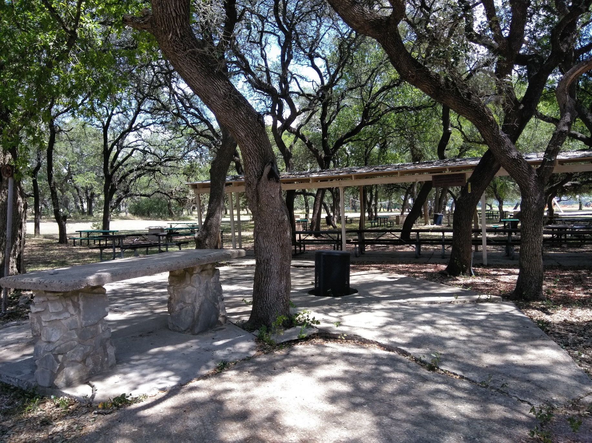
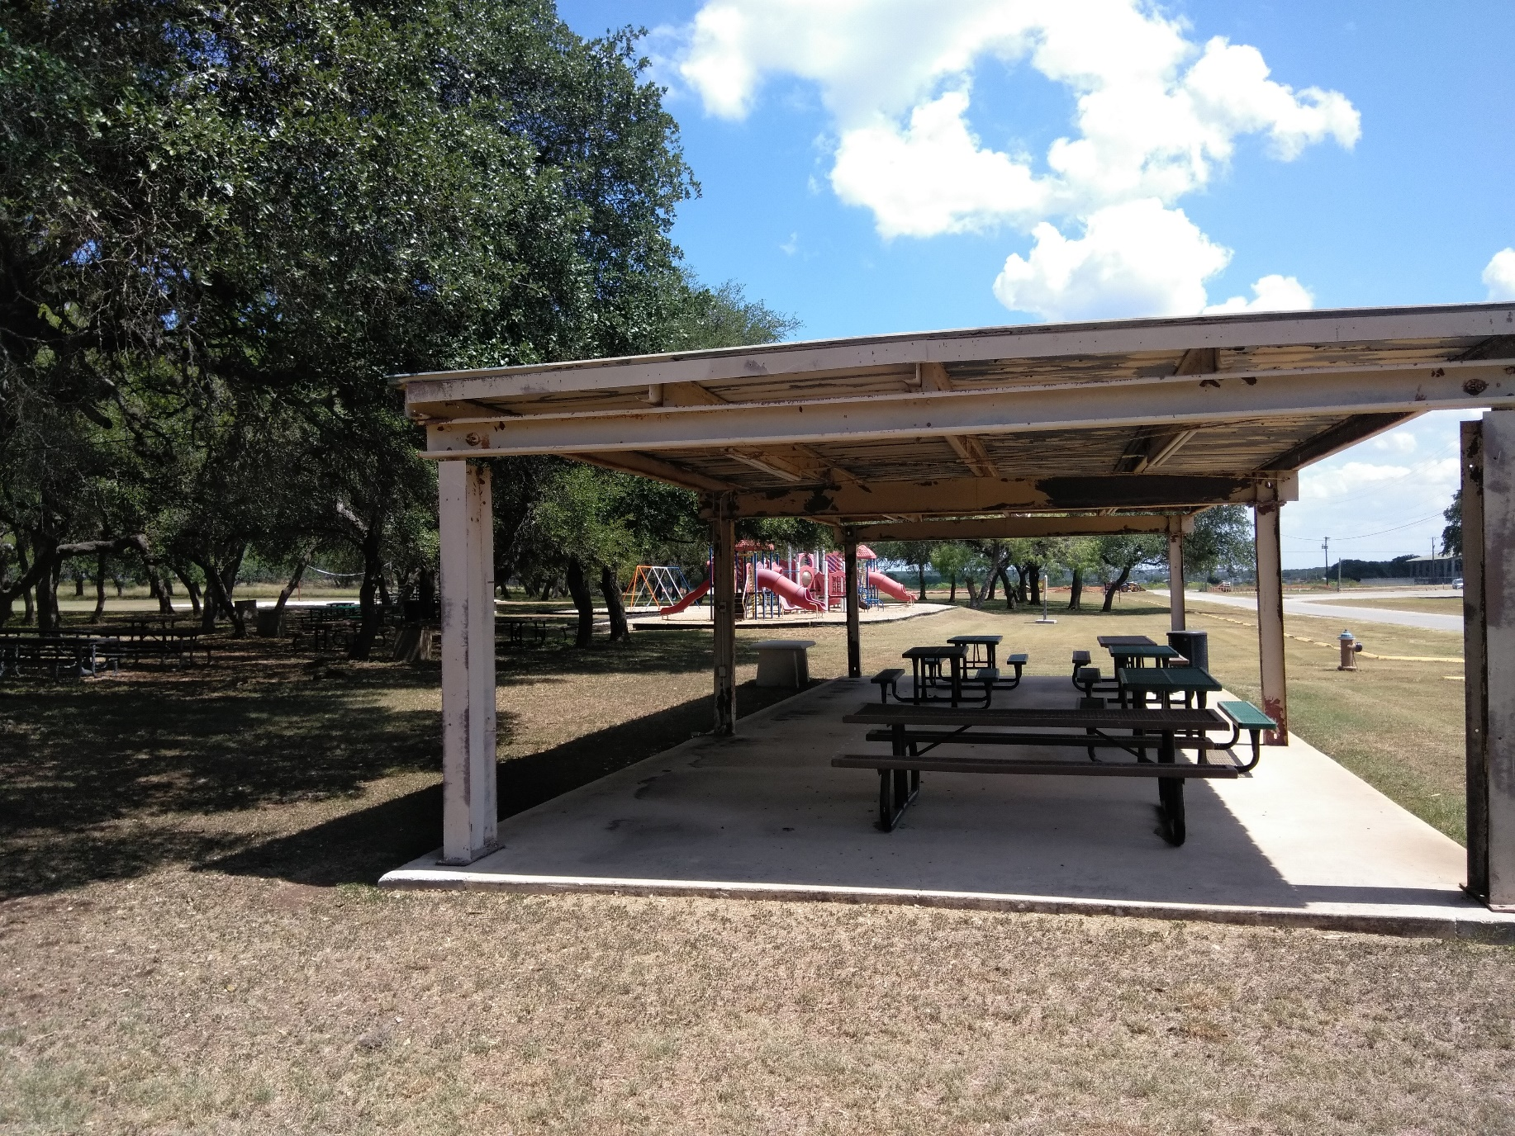
Prep Area
Head Table
Air Force ROTC Detachment 842 • We Build Exceptional Officers • The University of Texas at San Antonio

Slide 8
Seating Arrangements
Cadre and Wing Staff table/Guest
Grog
Golf
Juliet
Hotel
Kilo
That weird tree
India
Lima
Food Prep
and serving table
Non ops POC
Non ops POC
Podium
Air Force ROTC Detachment 842 • We Build Exceptional Officers • The University of Texas at San Antonio

Slide 9
Seating Head Table
Cadre Guest in middle left of him Capt C Right of him Col Cyrus
Wingstaff
Air Force ROTC Detachment 842 • We Build Exceptional Officers • The University of Texas at San Antonio

Slide 10
Prep station layout
Grill provided from the Rod and Gun
Carlos’s grill
Hdz Friend
Hernandez
Duquette
Mix drinks
Uncooked patties
Mix drinks
Arias
Wargo
Camacho
Buns
Mix drinks
Onions
Tomatoes
Lettuce
Air Force ROTC Detachment 842 • We Build Exceptional Officers • The University of Texas at San Antonio

Slide 11
Giving food layout
Drinks
Chips
Hdz Friend
Hdz
Arias
Wargo
Camacho
Duquette
Cheese
Cooked
Patties
Onions
Tomatoes
Lettuce
Condiments
Buns
Air Force ROTC Detachment 842 • We Build Exceptional Officers • The University of Texas at San Antonio

Slide 12
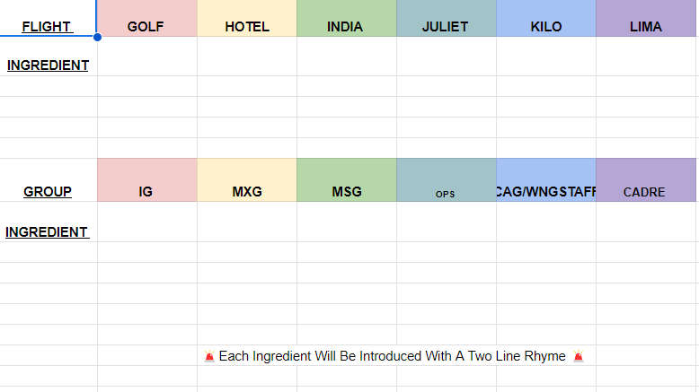
The Grog
Pending on ingredients
Container-reaching out to AAS for a toilet if not a bowl with pumpkins around it.
C/Betzel contacted previous AAS members for whereabouts.
Air Force ROTC Detachment 842 • We Build Exceptional Officers • The University of Texas at San Antonio

Slide 13
Script
LINK
Air Force ROTC Detachment 842 • We Build Exceptional Officers • The University of Texas at San Antonio

Slide 14
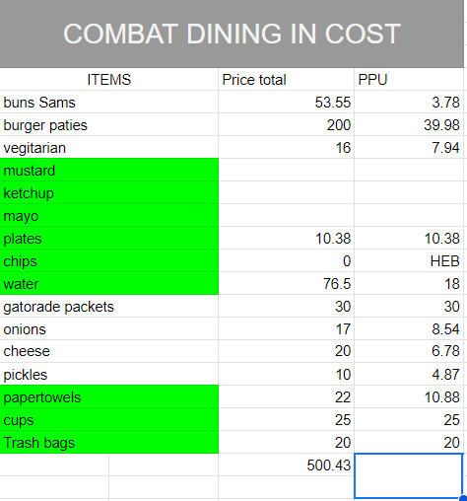
Cost
Contacted Stores: H.E.B, Bill Millers BBQ , Walmart, Sams, Target, only H.E.B has provided funds of 50$.
Green: Obtained Items
Extra Items found within the chain have helped lower the overall Cost.
Chips Marked by HEB due to their price and they can now be covered by the money given to us.
Air Force ROTC Detachment 842 • We Build Exceptional Officers • The University of Texas at San Antonio

Slide 15
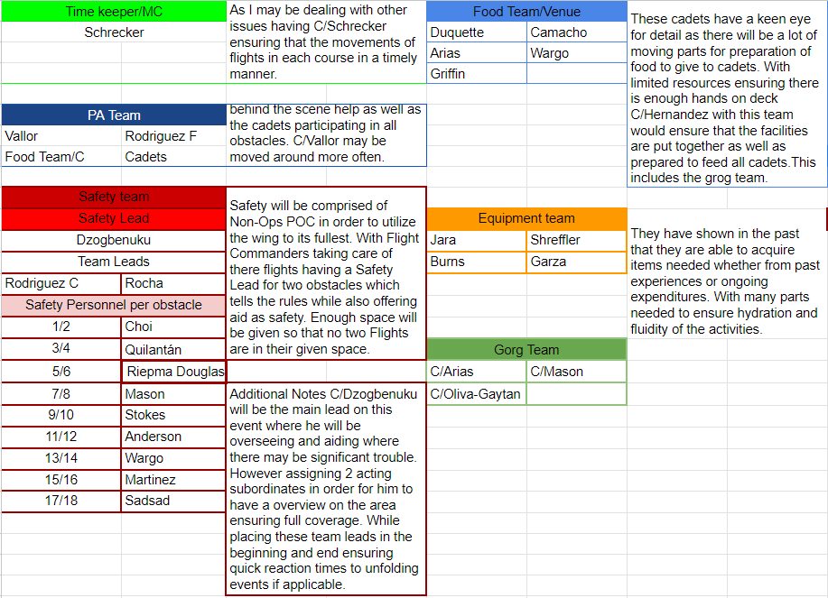
Positions

Slide 16
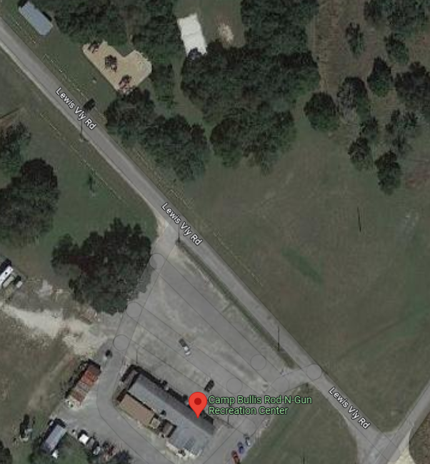
Additional Points
Parking for GMC and POC
If we march from the Rod-N-Gun we will utilize POC as Road Guards as to let GMC see what they do
In-Processing could be handed to Ops
GMC PARKING
POC PARKING
Air Force ROTC Detachment 842 • We Build Exceptional Officers • The University of Texas at San Antonio

Slide 17
Safety Team Plan
Safety Leads will be hovering between obstacles to oversee and address any issues regarding safety
Each team lead will have medkits in case of injuries
In case of severe injuries, incident will be recorded and reported to Cadre
Air Force ROTC Detachment 842 • We Build Exceptional Officers • The University of Texas at San Antonio

Slide 18
Summary
Schedule
Food Timeline
Potential Seating Layout
Prep/Serving Station Layout
The Grog
Costs
Confidence Course Questions
Positions
Additional Points
Air Force ROTC Detachment 842 • We Build Exceptional Officers • The University of Texas at San Antonio

Slide 19
Questions?

Slide 20
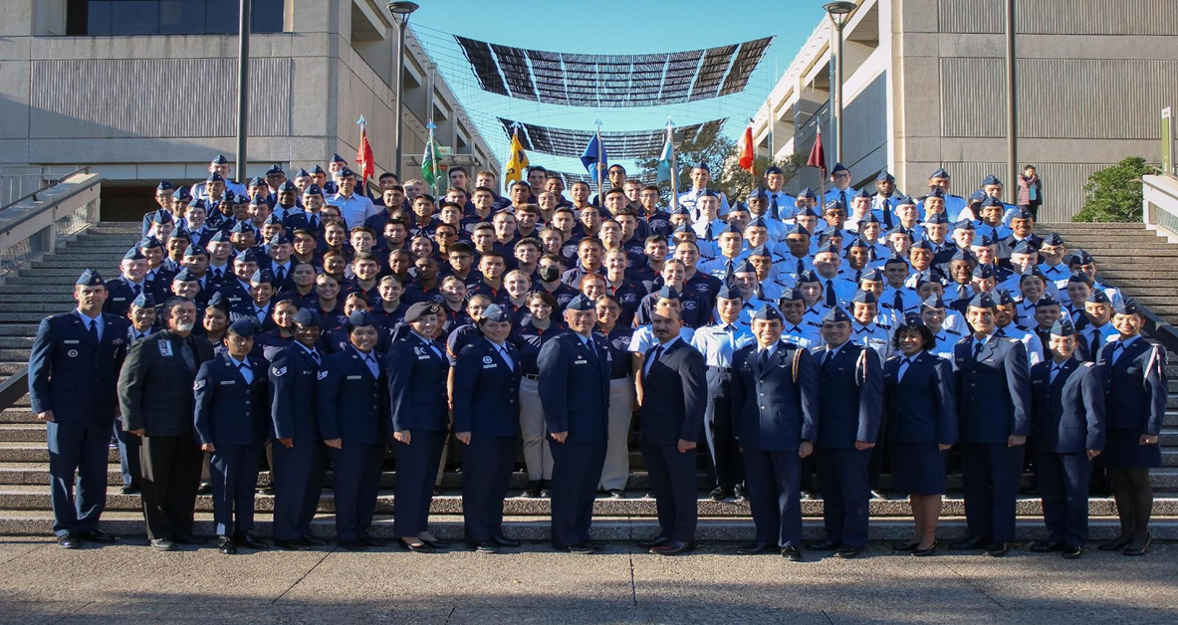
Air Force ROTC Detachment 842
The University of Texas at San Antonio
Det 842 – Best in Blue

